Slide 1

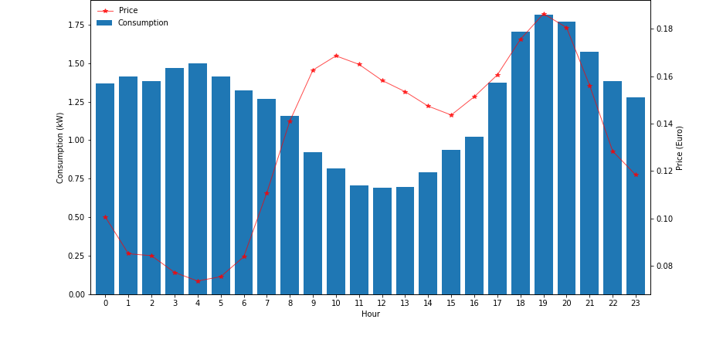
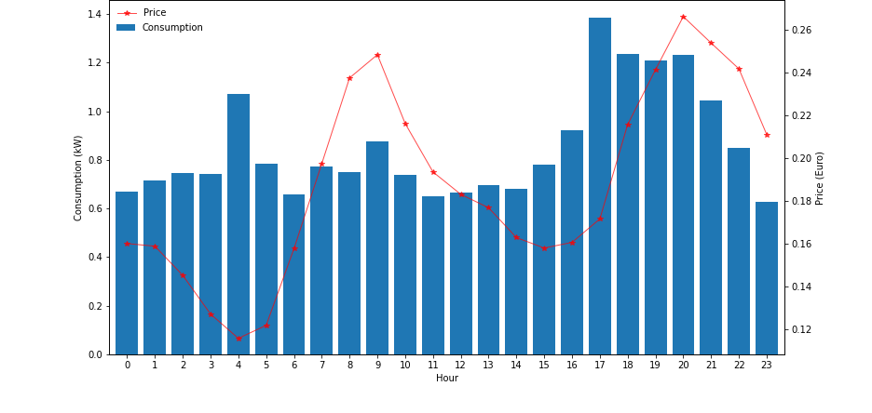

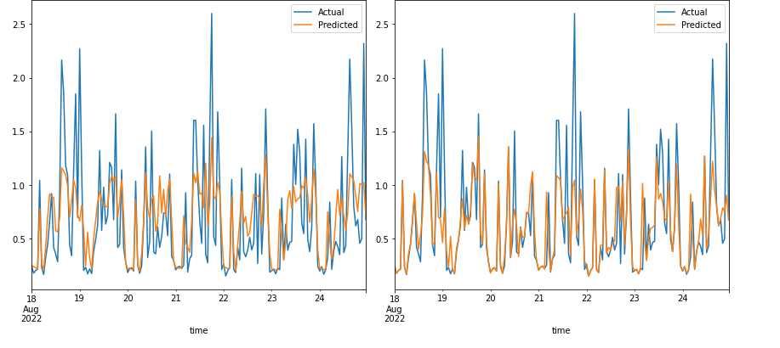
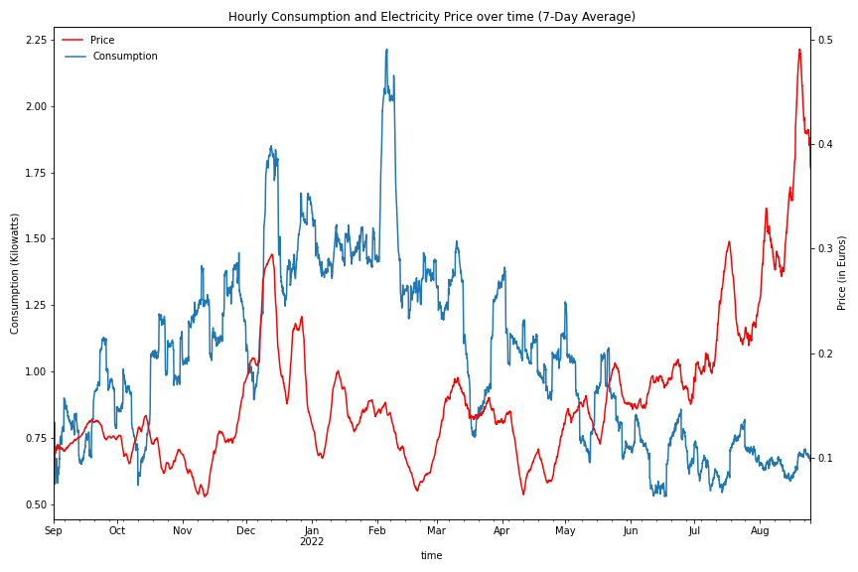
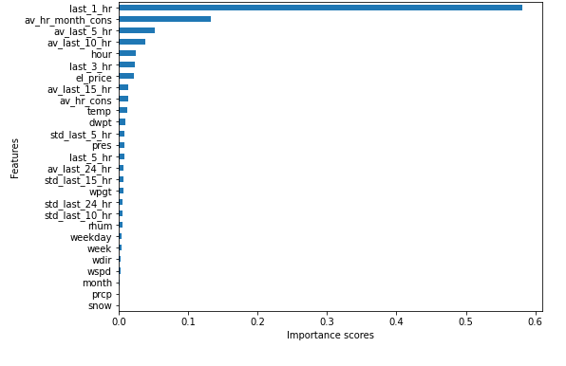
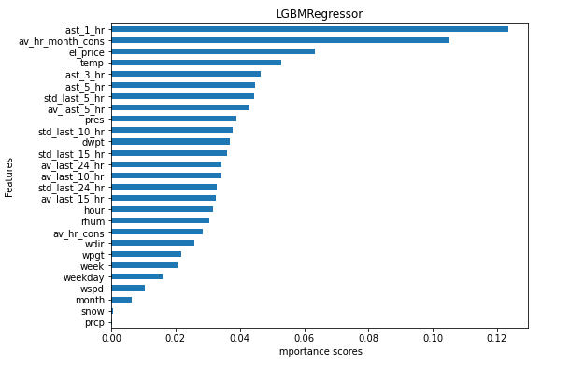
Journey to zero - Predict electricity consumption
Chigozie Nkwocha , Patricia Kika Obinwanne, Wei-Chieh Wang
Institute of Computer Science, University of Tartu, Narva mnt 18, 51009, Tartu, Estonia
Introduction
Effect of the invasion of Russia on Ukraine
With the ever-increasing complexities in the global economy from the invasion of Ukraine by Russia, electricity prices have skyrocketed, and consumers around the world are looking for options to reduce electricity costs.
One way would be to seek an alternative source of energy through the use of solar panels and other various forms of electricity generation.
However, A major concern is that seeking alternative energy sources would lead to the business losing money from more customers withdrawing their patronage.
Goal of the project: Develop an energy consumption machine learning model to predict electricity consumption for a single household for the next seven days.
(A)
(B)
Figure 2. (A) Hourly Consumption rates Pre-Russian Invasion (B) Hourly Consumption rates During Russian Invasion
Workflow
The average consumption rate before the invasion was 1.24 kW and 0.85 kW after the invasion. Also, the electricity price pre-invasion was about 13 cents, while during the invasion, it increased to about 19 cents.
There was a statistical difference in consumption rates and electricity prices pre-invasion and post-invasion. Hence, we rejected our null hypothesis and that the invasion of Russia on Ukraine significantly affected the electricity prices and consumption rates.
Data Analysis
Household electric Consumption Evaluation
Invasion Effect Evaluation
Data Preparation
Table 1. T-test statistical results on the effect of the invasion of Russia on Ukraine on electricity price and consumption rates
Time-series features generation
Missing values correction
Model Training
ARIMA
Random Forest
Gradient Boosting
 | Electricity prices | Consumption rates
T-statistic | -22.163 | 16.584
P-value | 3.074 x 10⁻¹⁰⁵ | 9.716 x 10⁻⁶¹
Data Preparation
The missing values in variables, one-hour precipitation total (prcp) and snow, were filled with zeros since precipitation and snow are non-existent at those times of the year.
The time variable was converted to date type, and features such as the month, hour, weekday and week of the year were extracted to be used for modelling.
To forecast future data, we approached the task as a time series model. A classical time series model, auto-regressive integrated moving averages (ARIMA), and two machine learning models, a random forest algorithm and a light gradient boosting algorithm were used.
For ARIMA, the distribution of the target variable was transformed to resemble a normal distribution. Meanwhile, for the machine learning models, no transformation was done.
Historical data was split into two in a time-series fashion, where hourly consumption for the last seven days was used for validation.
The performance of the models was evaluated based on mean absolute error (MAE), and root mean squared error (RMSE).
Model Training
Table 2. Model performance for three models on validation data
Metric | ARIMA | Random Forest | Gradient Boosting
MAE | 0.4359 | 0.3307 | 0.3272
RMSE | 0.6099 | 0.4480 | 0.4754
(A)
(B)
Household Electric Consumption Evaluation
Figure 3. Difference between the predicted and ground-truth values for (A) random forest and (B) Light Gradient Boosting (LightGBM)
Based on the MAE on the validation data, the gradient boosting algorithm from the lightGBM library was selected as the best model, with an MAE of 0.3272.
The difference between the ground truth and the predicted values for the two better machine learning models seemed to have the same pattern. More specifically, the models might not be able to predict the data with relatively high ground truth correctly.
Based on the feature importance plot, it is found that consumption in the last hour is a strong determinant of consumption in the next hour. Similarly, the average hourly consumption per month, the electricity price, the hour, temperature, and average consumption past n hours are other strong determinants of hourly consumption for a household in the next seven days.
Figure 1. Hourly Consumption and Electricity Price over time (7-Day Average)
(A)
(B)
The hourly consumption rates increased toward the end of the winter, with the highest average consumption of 2.20kW recorded in around the first week of February.
From March 2022, electricity consumption has dwindled, hovering around 1kW per hour between June and August 2022.
Electricity prices cost the highest in December 2021, around 27 cents per hour. From January to April, electricity prices fluctuated within 20 cents per hour, lower than in December. However, from April to August, there has been an upward trend in electricity prices, increasing to almost 50 cents per hour in August (the highest recorded price).
Figure 4. Feature importance plots for (A) random forest regressor and (B) light gradient boosting regressor

